Slide 1

Mark 01 Slides

Slide 2
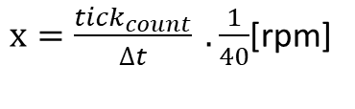


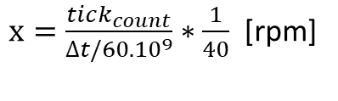

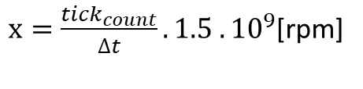

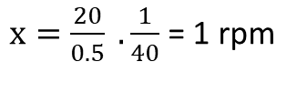
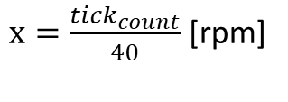


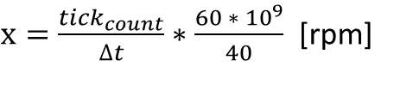
Wheel Encoders – convert tick to rpm
$$1 rpm −40\frac{ticks}{min}$$
$$∆t →nano seconds$$
Our software will measure the delta_t in nano seconds
Our wheel encoder has 40 ticks per revolution
$$1\min{=60. {10}^{9}ns}$$
$$x rpm −\frac{tick_{count}}{min}$$
$x=\frac{tick_{count}}{∆t/60.{10}^{9}}∗\frac{1}{40}$ [rpm]
$x=\frac{tick_{count}}{40}$ [rpm]
So our speed x in rpm is
$x=\frac{tick_{count}}{∆t}∗\frac{60 ∗ {10}^{9}}{40}$ [rpm]
$x=\frac{tick_{count}}{∆t} . \frac{1}{40}$[rpm]
Same formula as before but with time delta in ns instead minutes. But our speed x still in rpm.
$x=\frac{tick_{count}}{∆t}.1.5 .{10}^{9}$[rpm]
Example:
$$∆t=0.5 min$$
$$tick_{count} =20$$
$x=\frac{20}{0.5} . \frac{1}{40}$ = 1 rpm

Slide 3

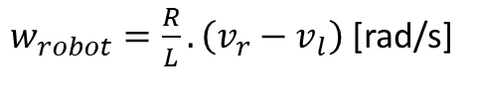

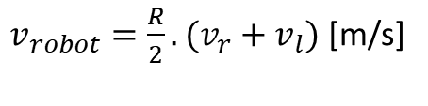


Wheel Encoders – speed formulas
$$v_{rad/s}=v_{rpm}.\frac{π}{30}$$
$$v_{l}$$
$$v_{r}$$
Convert rpm to rad/s
R
$v_{robot}=\frac{R}{2}.(v_{r}+v_{l})$ [m/s]
Robot speeds
$w_{robot}=\frac{R}{L}. \left(v_{r}−v_{l}\right)$ [rad/s]
L
$$∅$$
(x,y)
Reference: Control of Mobile Robots Course – Georgia Tech (https://www.youtube.com/watch?v=aE7RQNhwnPQ)

